Slide 1
TOSN Paper Summary
Steven Lai

Slide 2
Energy-Efficient On-Demand Reprogramming of Large-Scale Sensor Networks
Propose a protocol called Freshet for reprogramming WSN
Advantage of Freshet over existing reprogramming protocols (if multiple sources available):
Optimize energy for code upload
Speed up the dissemination speed

Slide 3
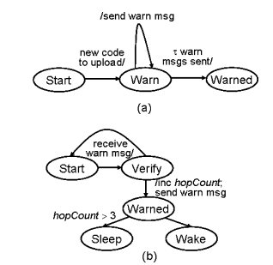
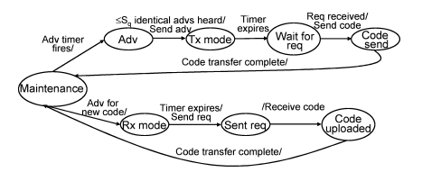
Protocol Design

Slide 4
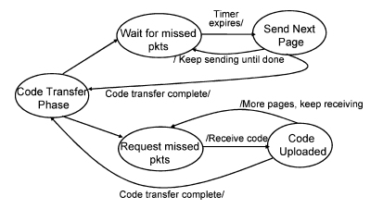
Multipage Mode

Slide 5
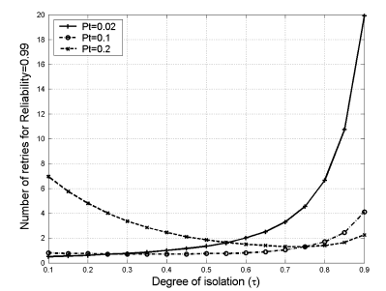
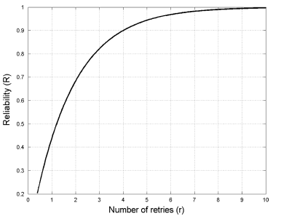
Evaluation 1

Slide 6
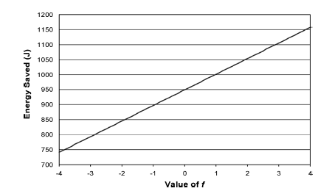
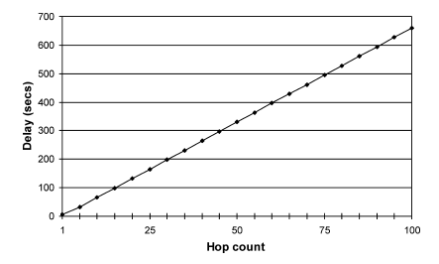
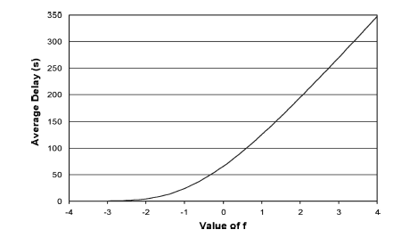
Evaluation 2

